Slide 1

DATA ANALYTICS WITH PYTHON
A Presentation on Ride_Sharing Dataset
Ea

Slide 2

Table Of Content
Case Study
Objectives
Python Modules Libraries Used
Analysis Made
Conclusion
Recommendations

Slide 3

CASE STUDY:
A Bicycle Ride company wants to have an insight and upgrade of its company based on the following:
User Retention and Growth
User Experience Improvements
Target Marketing
Optimize Bike Allocation
Station Management (Target Expansion and Optimize Infrastructure).
As a Data Analyst, analyze the given dataset of the company to make a strategized and developmental upgrade.

Slide 4
OBJECTIVES
Distribution of User Gender Across Different Bike IDs
Proportions of Male and Female Users among user types
Average rides per birth year
Duration by user gender and bike ID
Top 5 Frequently Used Station Name in Station A and User Gender
Top 5 Frequently Used Station Name in Station A and User Gender

Slide 5




Python Libraries Used
NUMPY
Multi-dimensional array objects, Data manipulation
Scientific computations Statistics for machine learning algorithms.
SEABORN It a powerful Python data visualization library built on top of Matplotlib.
It provides a high-level interface for creating visually appealing and informative statistical graphics.
SCIPY
Collection of sub-package, Mathematical computations
Advance linear algebra functions,upport signal processing
PANDAS
Process large data sets,Complex data analysis
Data frame objects,Time series data
MATPLOTLIB
Extract quantitive information ,Plot a variety of graphs
Integrate with tools

Slide 6
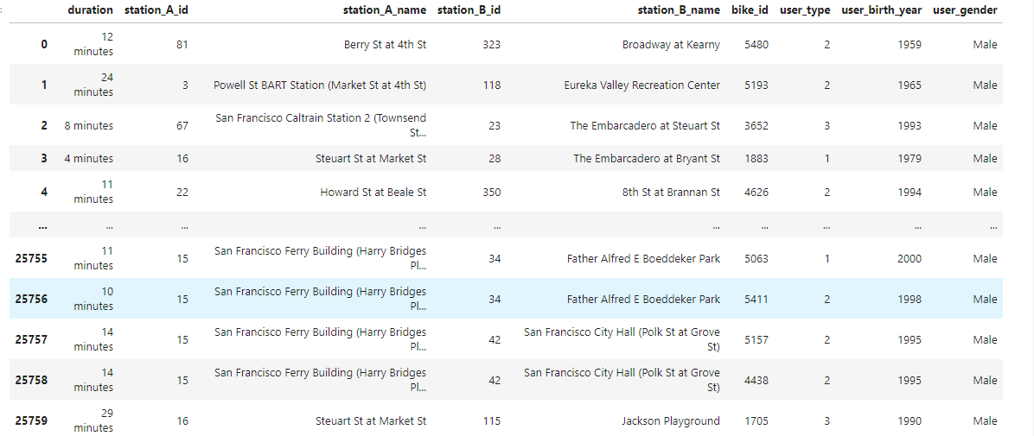

Slide 7
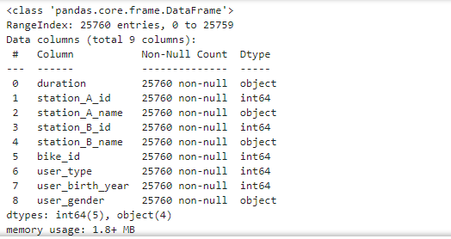
Cross checked and got to know there are non-null values

Slide 8
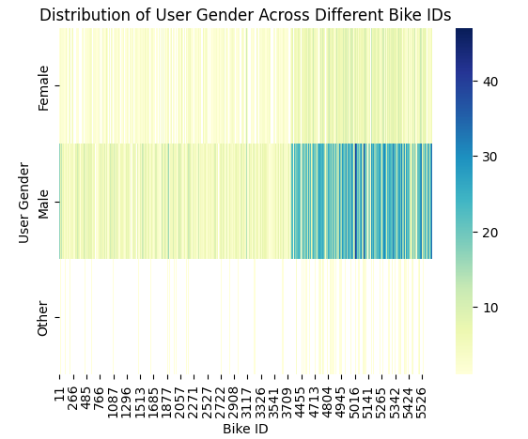
This analysis helps the company to know how to optimize bike allocation as mentioned in the case study of the presentation.

Slide 9
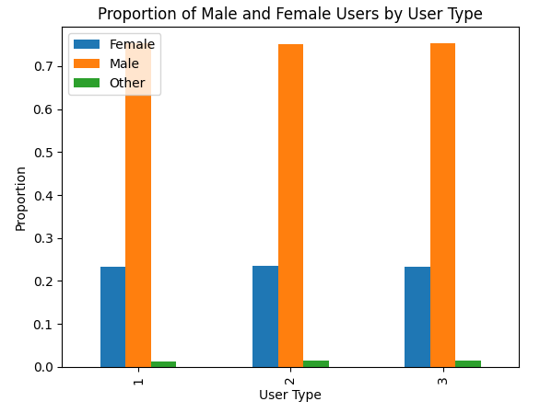
With the help of this graph we got to know that there is no proportional difference of gender users among the company’s user type.

Slide 10
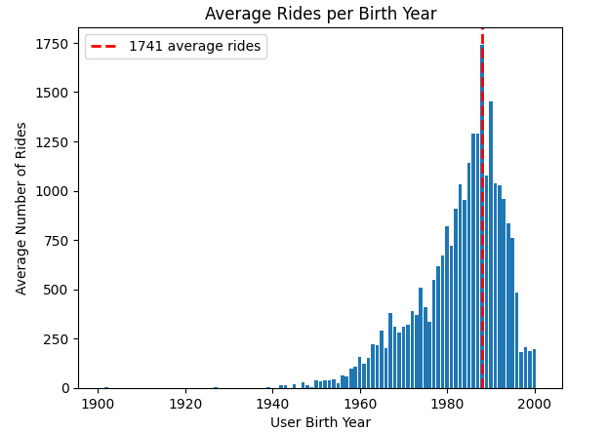
Average birth year for users who take the most rides: 1988 Average number of rides for users born in 1988: 1741

Slide 11
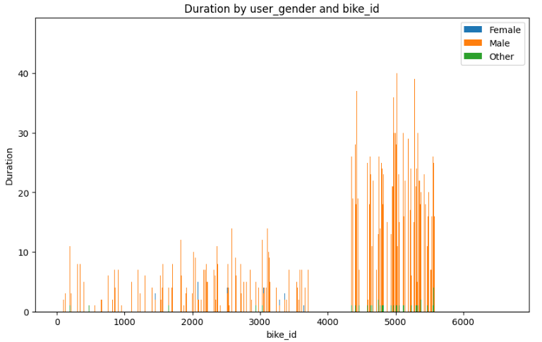

Slide 12
CONCLUSION.
At the end of our analysis :
We were able to provide a solution and visualize information that will help the company to strategized and make a developmental decision in the company, whiles providing their customers with satisfaction when it comes to the kind of bicycles they prefer and use the most and on the station they use frequently

Slide 13
RECOMMENDATIONS
The company should develop a real time ride tracking and estimated
arrival times.
The company should develop an advance algorithm to forecast demand trend, helping in proactive ride scheduling
Establish a data analytics team to regularly monitor key metrics and trends.

